Slide 1


@!a%$^s
Test Driven Development

Slide 2
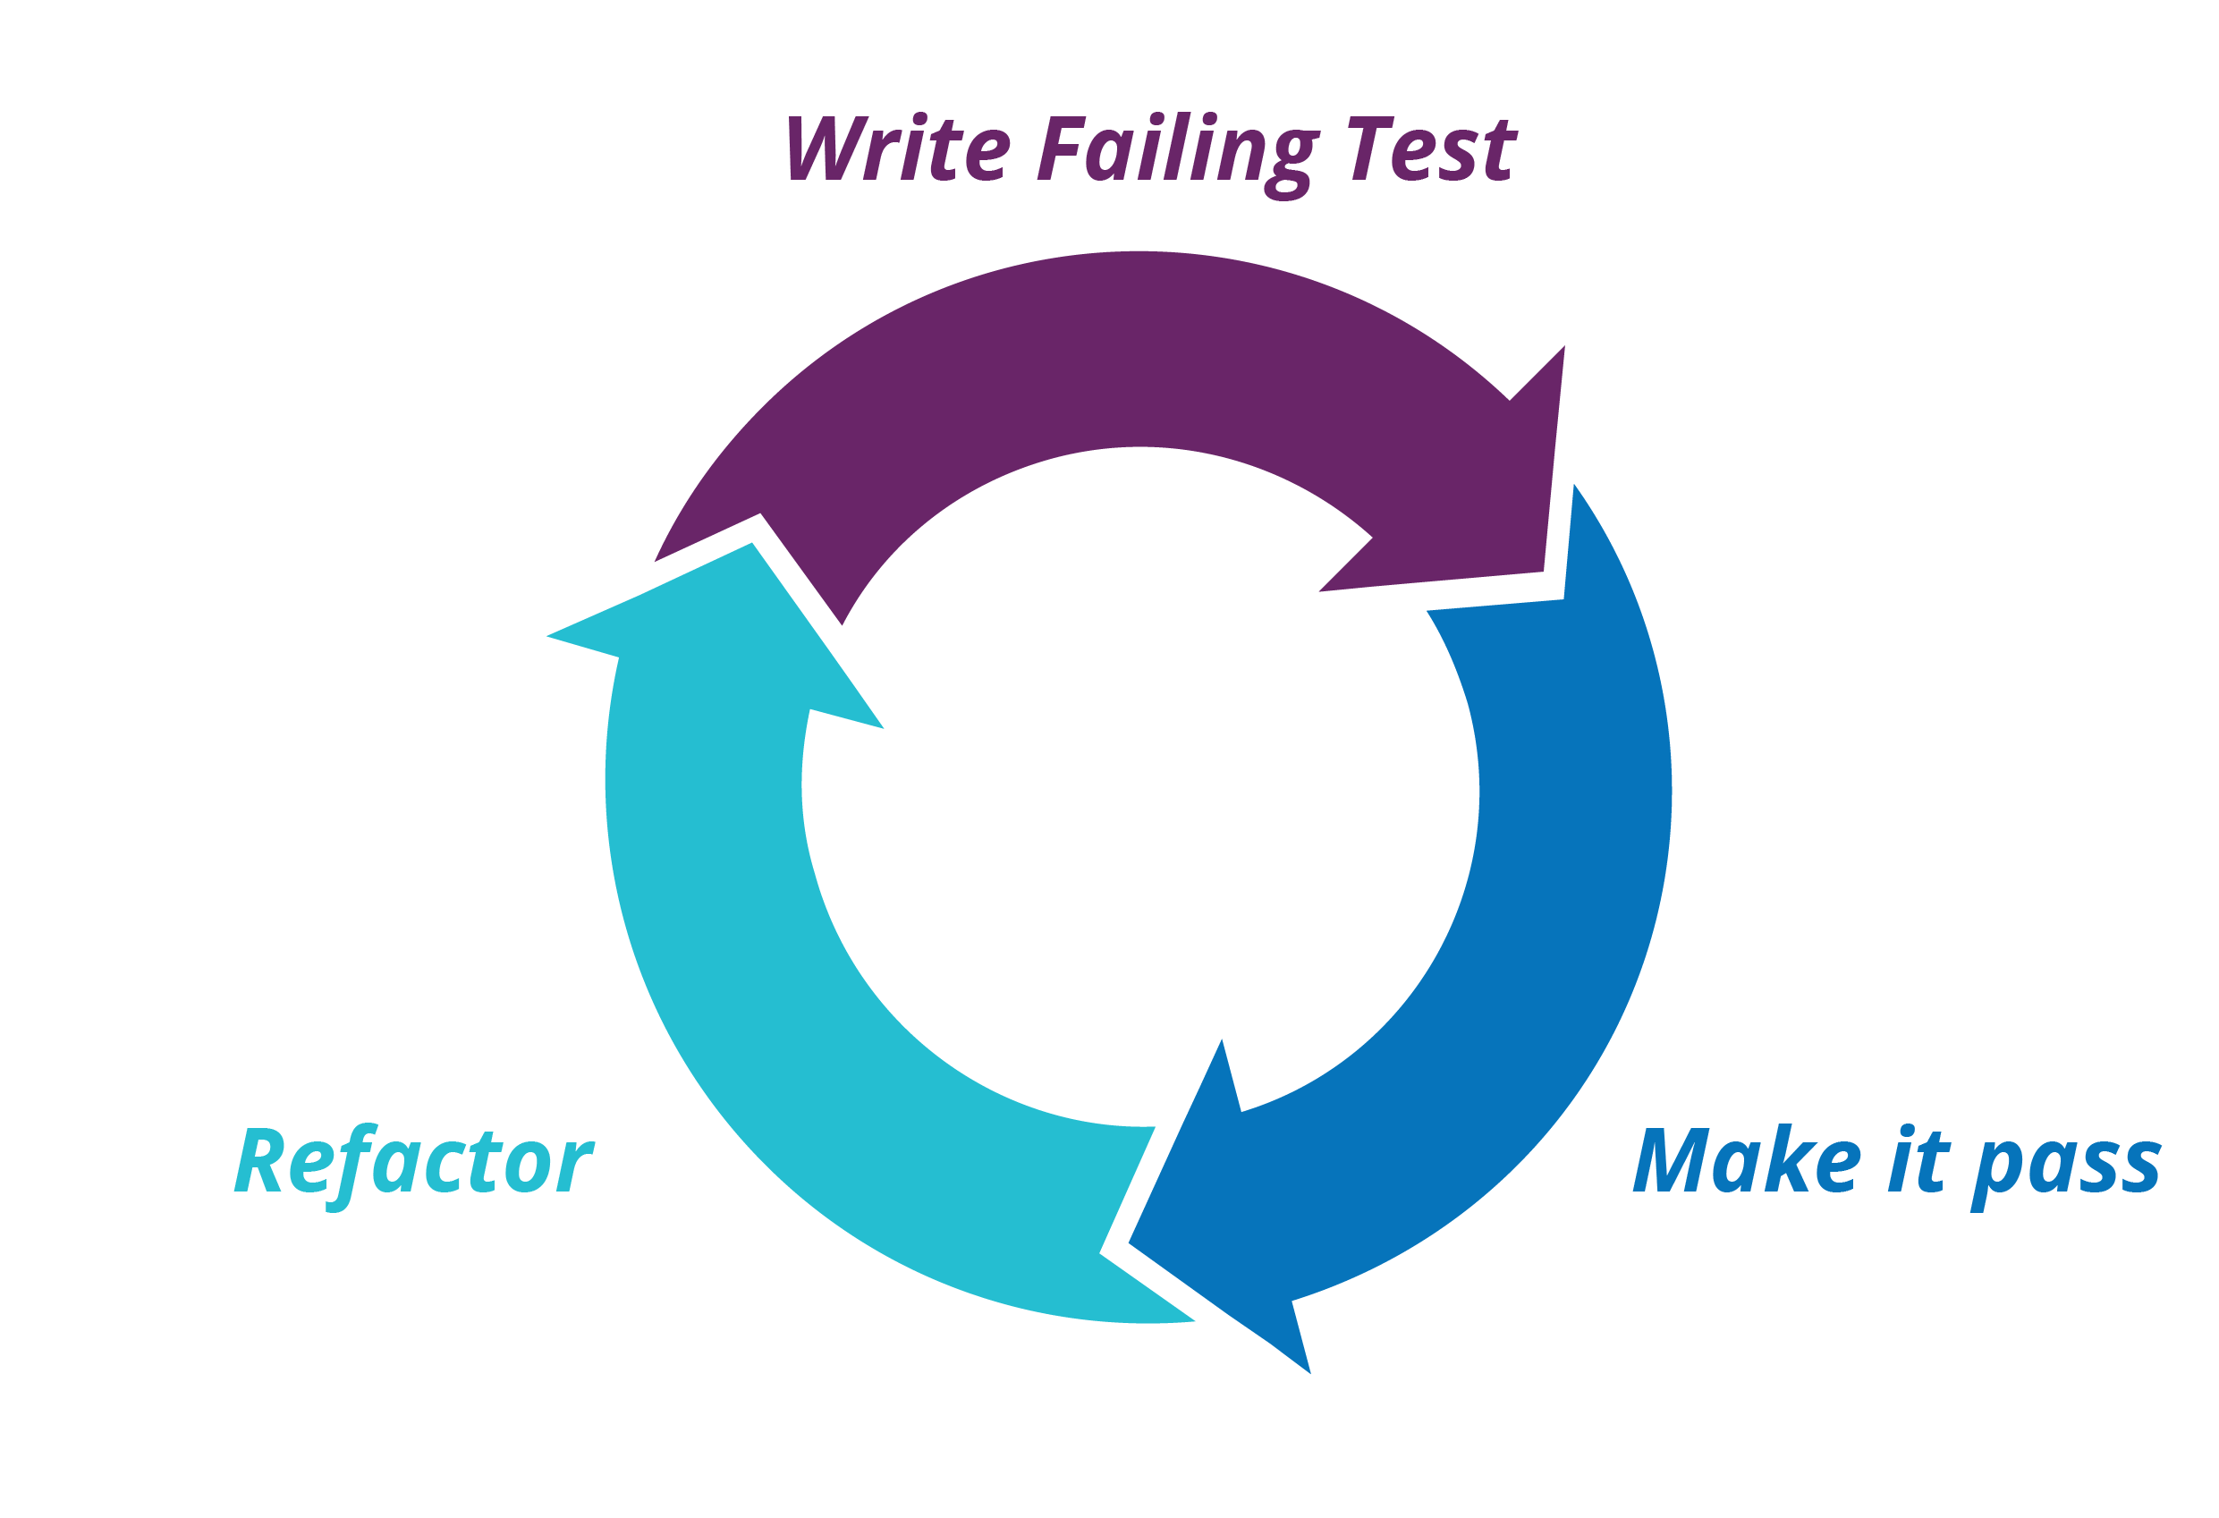
Strategy
Write test
Make it pass
Refactor

Slide 3
Unit Test, Property based Test
Unit Test:
Eazzy
Quick
That’s it!
Property-based Testing:
Write takes more time
Takes more time to run
Refactoring code might take more time
Covering edge cases
Most of the cases is simply powerful!

Slide 4
Property-based testing
Property-based Testing
Define properties about the code. “For example: you have a function that calculates sin Set[-1,1]”
Creates randomized inputs to ensure the defined properties are correct

